Slide 1
Findings Research Rapport
14/12/25

Slide 2
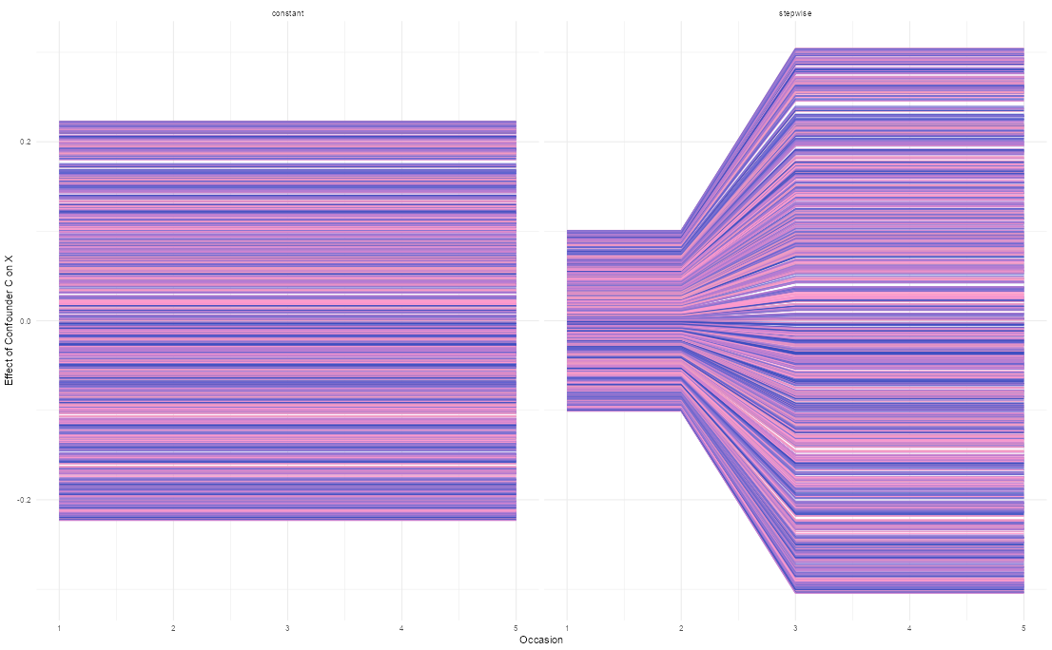
Study 1: effect of C on X (left) and Y (right)

Slide 3
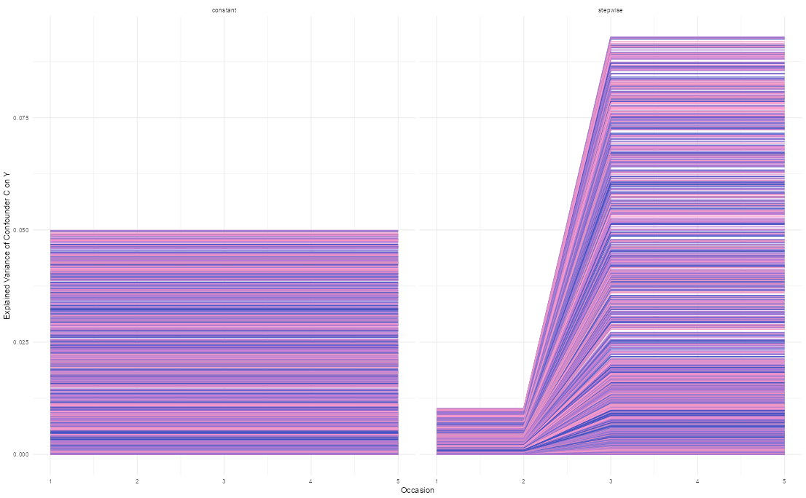
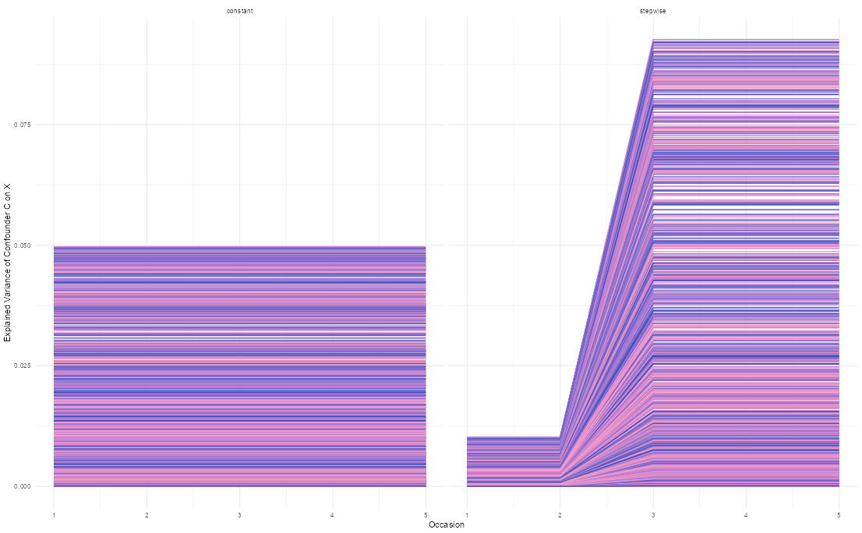
Study 1: variance explained of C on X (left) and Y (right)

Slide 4
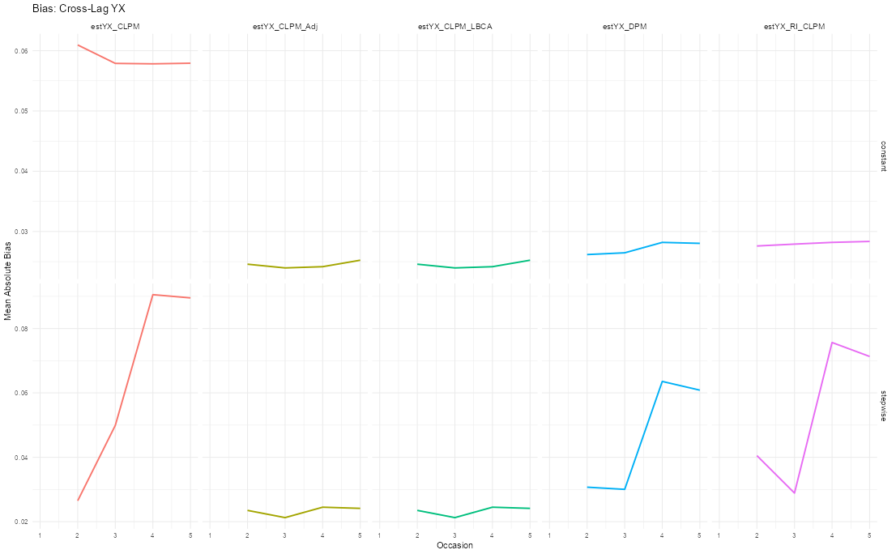
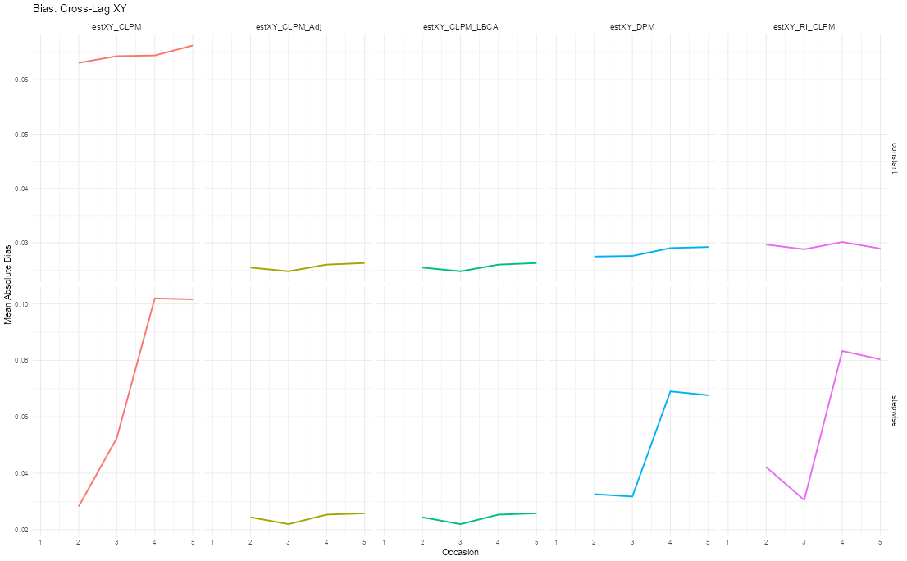
Study 1: Bias of XY (left) and YX (right)

Slide 5
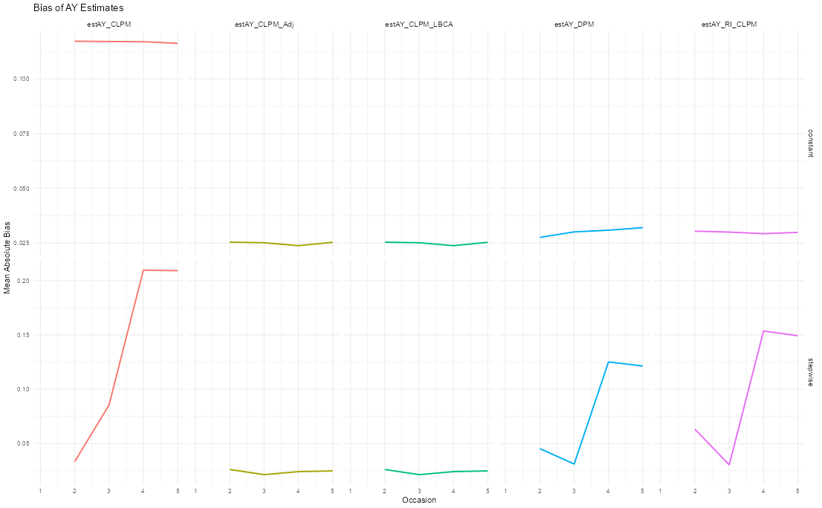
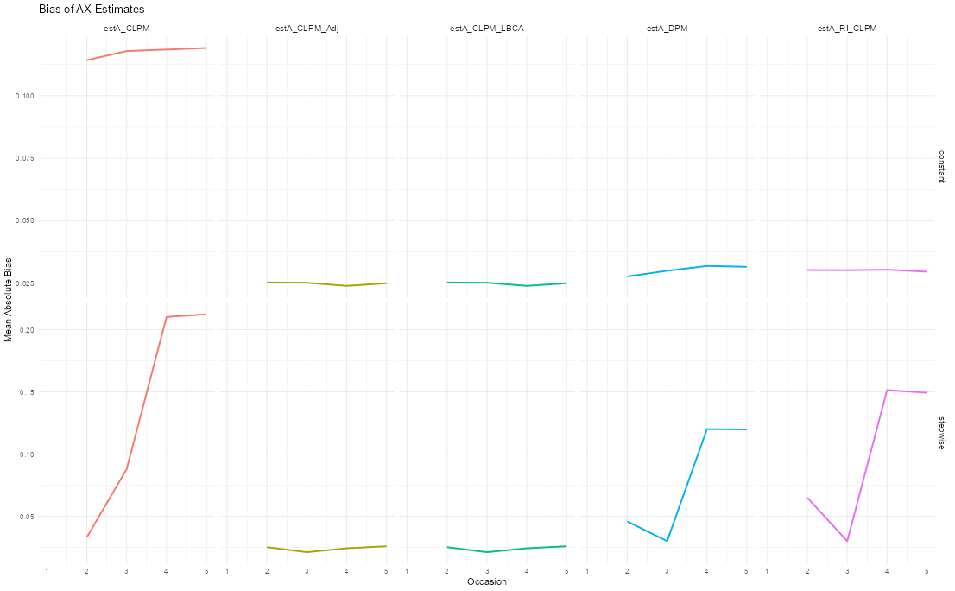
Study 1: Bias of AX (right) and AY (left)

Slide 6
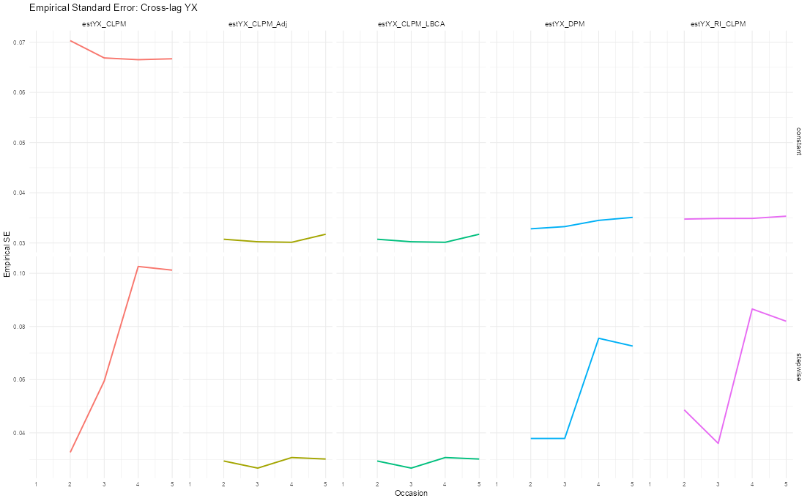

Study 1: Empirical Sd for XY (right) and YX

Slide 7
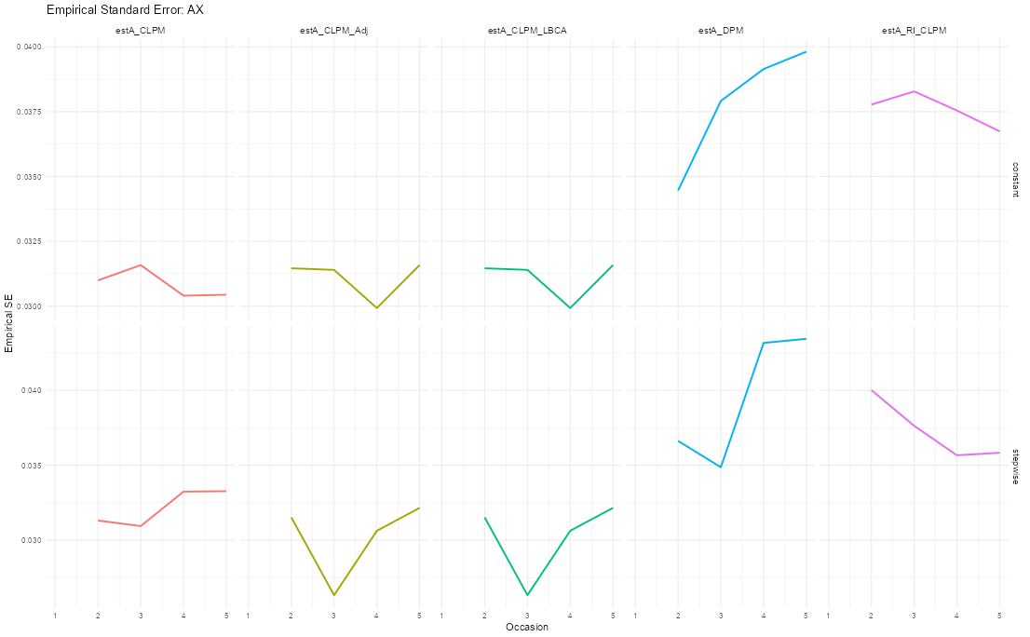
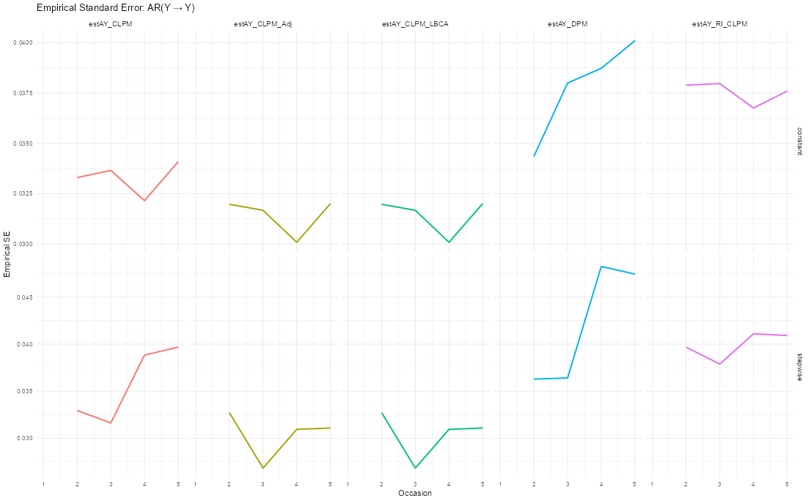
Study 1: Empirical Sd for AX (left) and AY

Slide 8
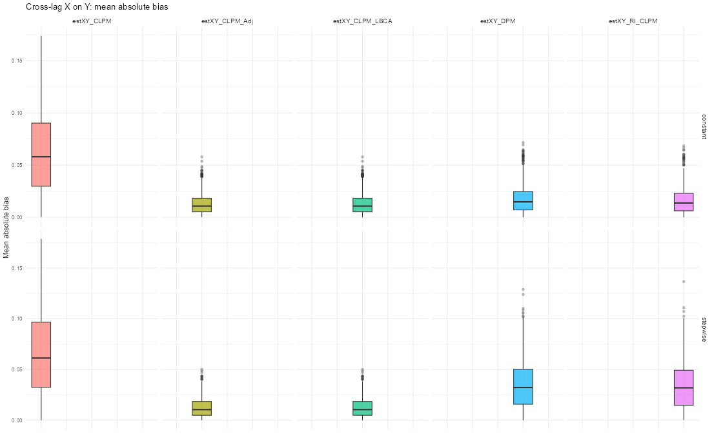
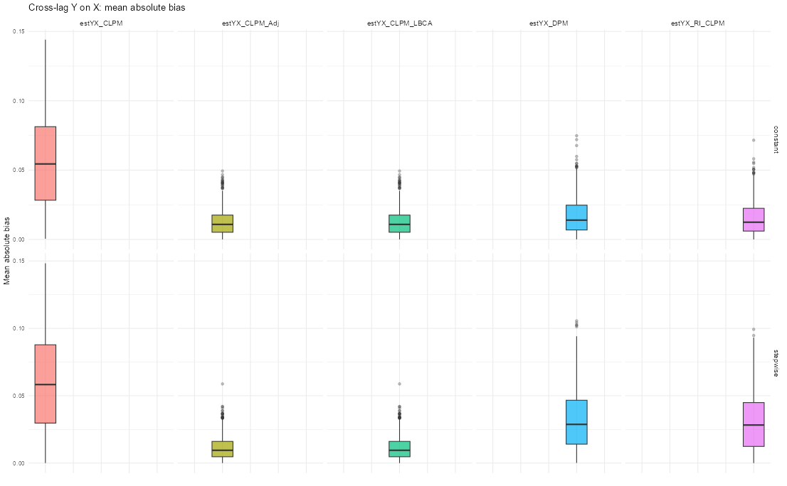
Study 1: Bias of XY (left) and YX (right)

Slide 9
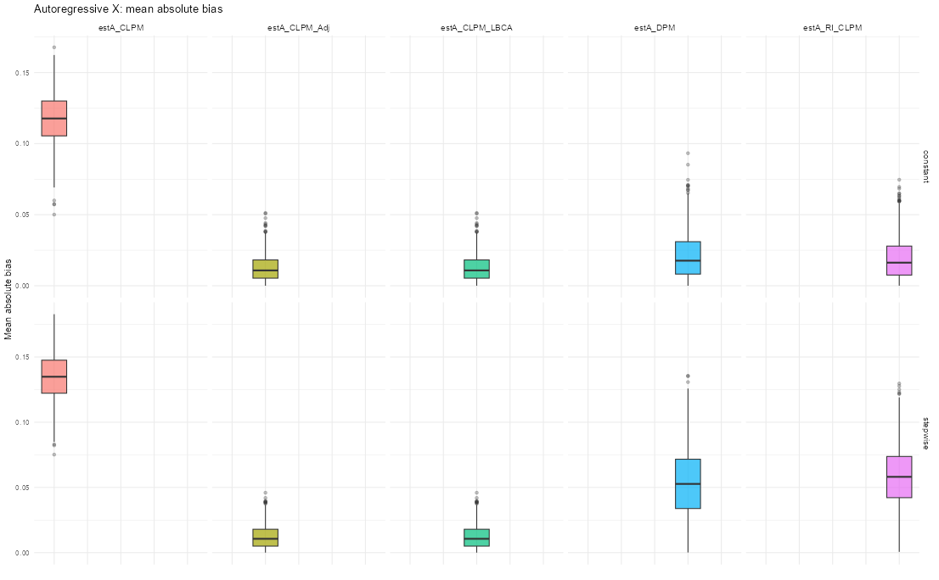
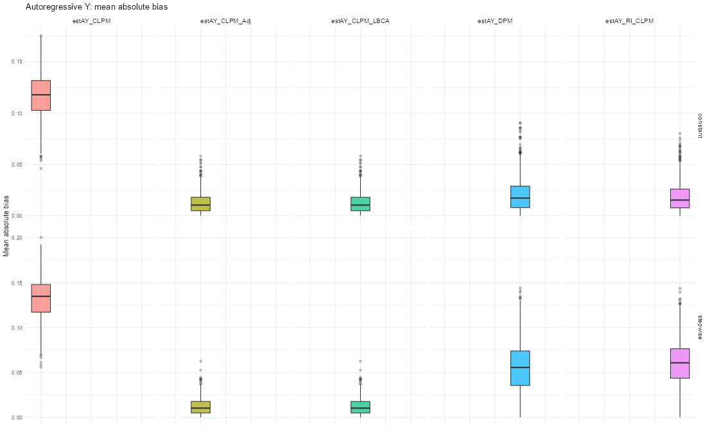
Study 1: Bias of AX (right) and AY (left)

Slide 10
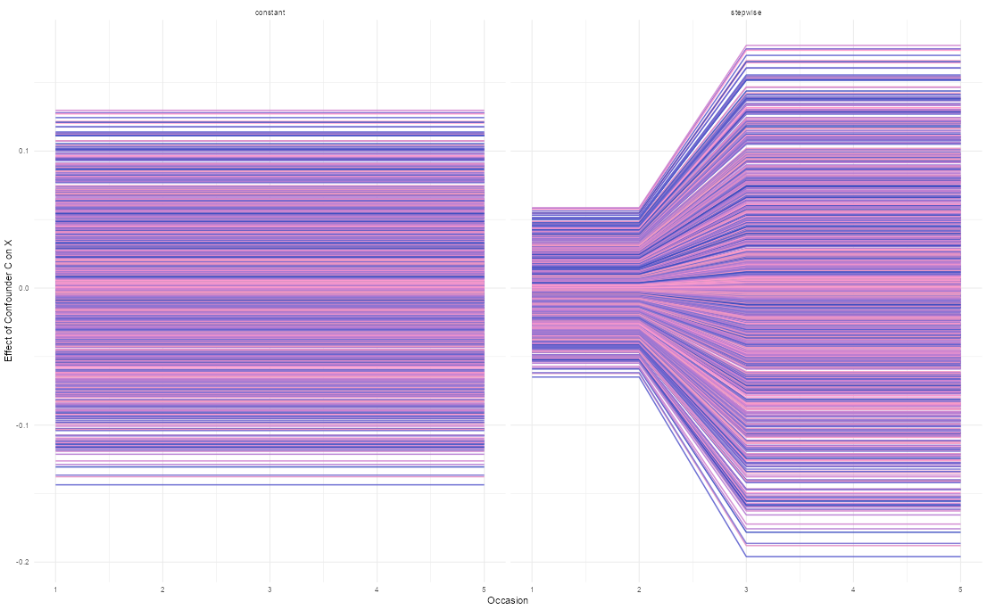
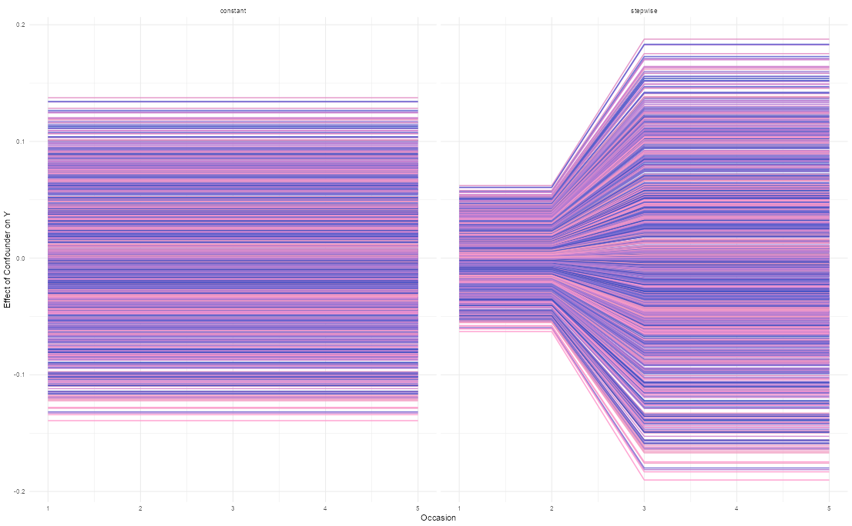
Study 2: effect of C on X (left) and Y (right)

Slide 11
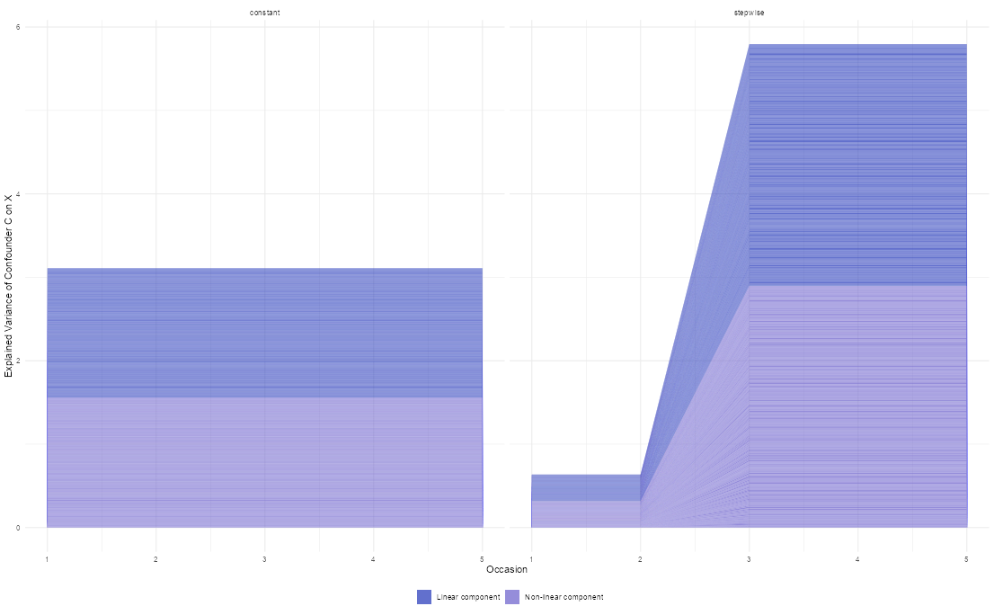

Study 2: variance explained of C on X (left) and Y (right)

Slide 12
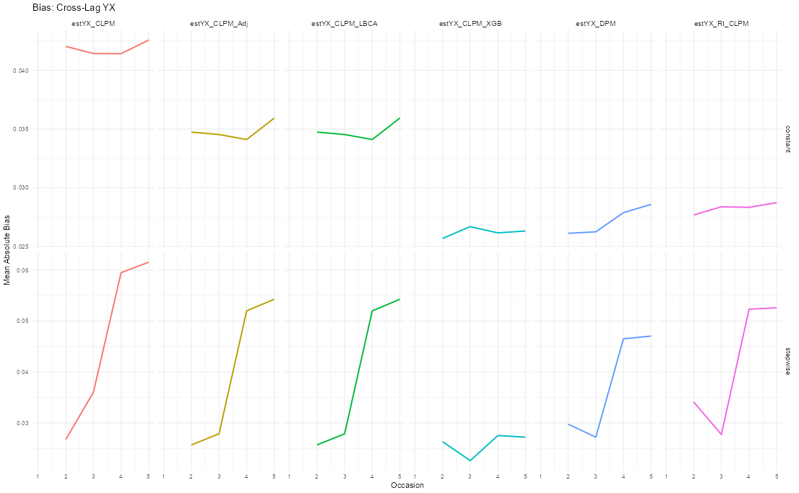
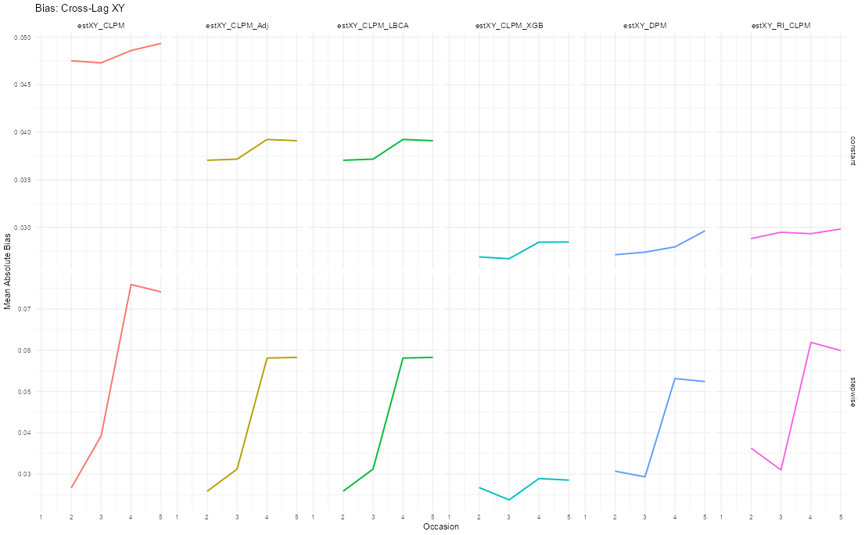
Study 2: Bias of XY (left) and YX (right)

Slide 13
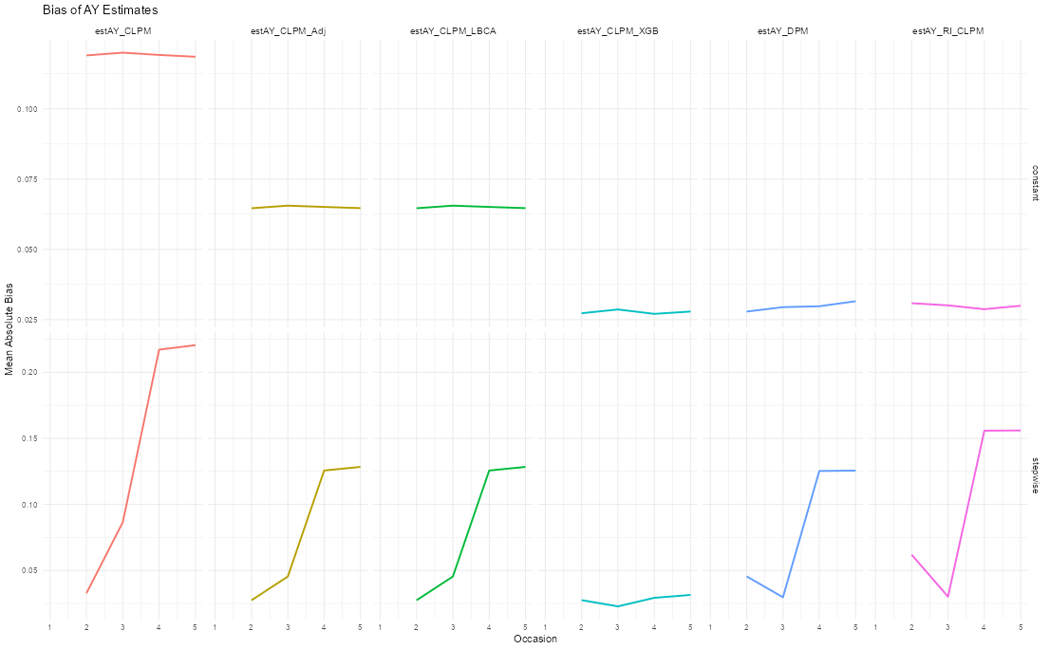

Study 2: Bias of AX (right) and AY (left)

Slide 14
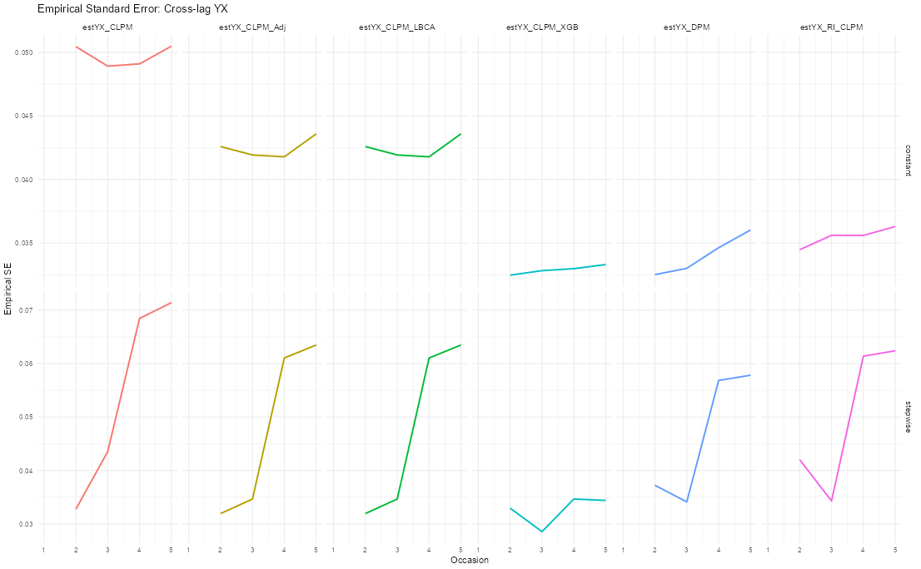
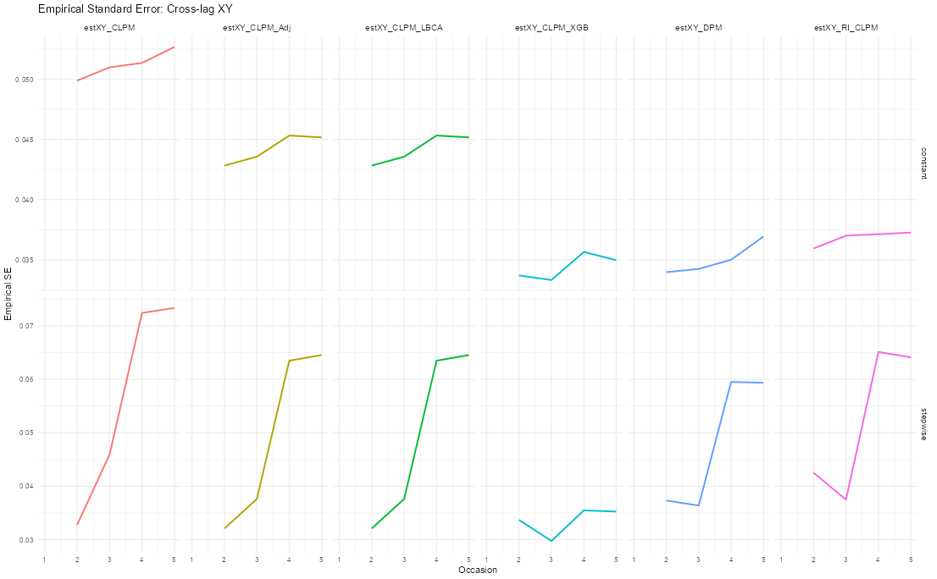
Study 2: Empirical Sd for XY (right) and YX

Slide 15
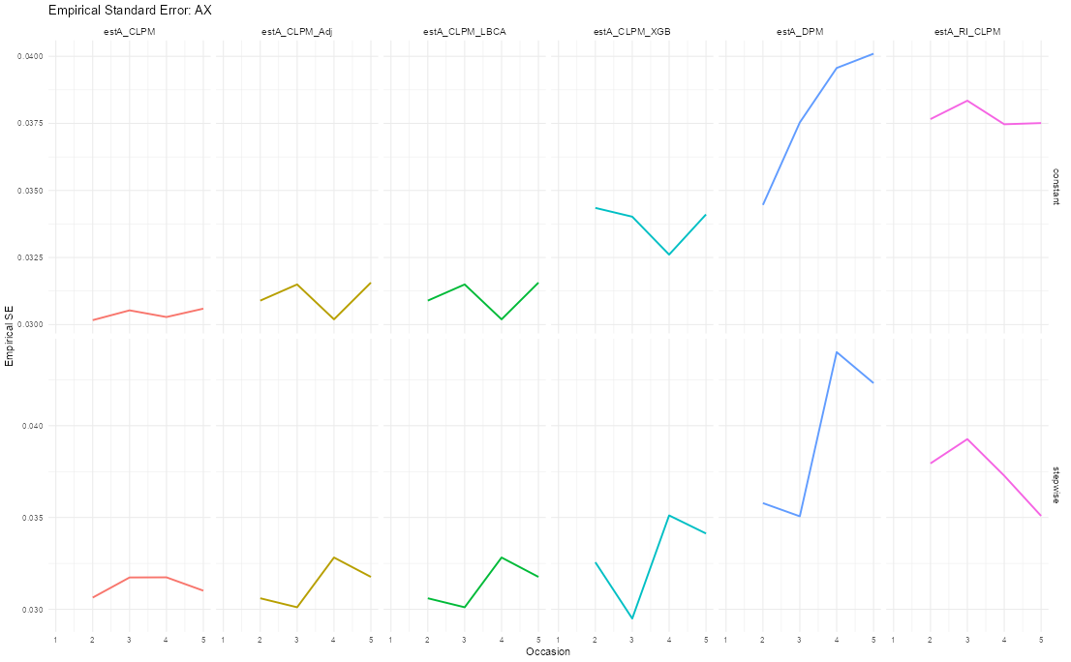
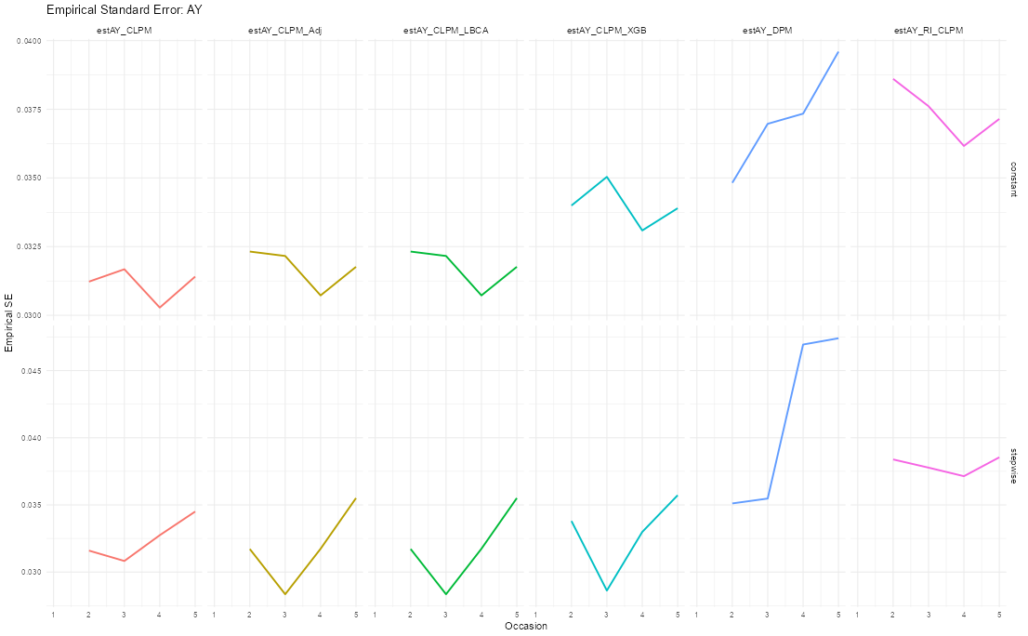
Study 2: Empirical Sd for AX (left) and AY

Slide 16
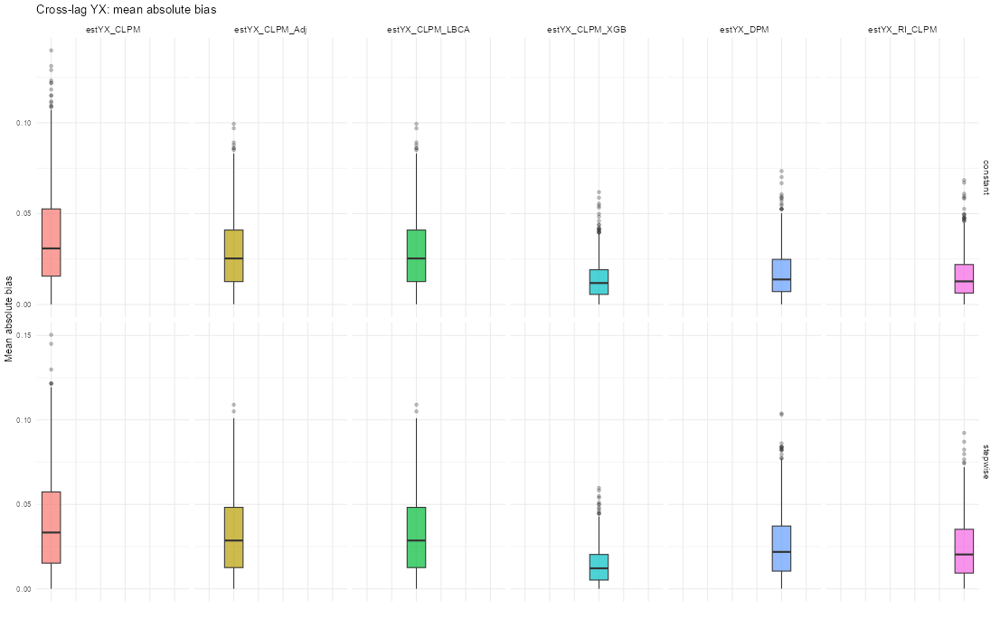
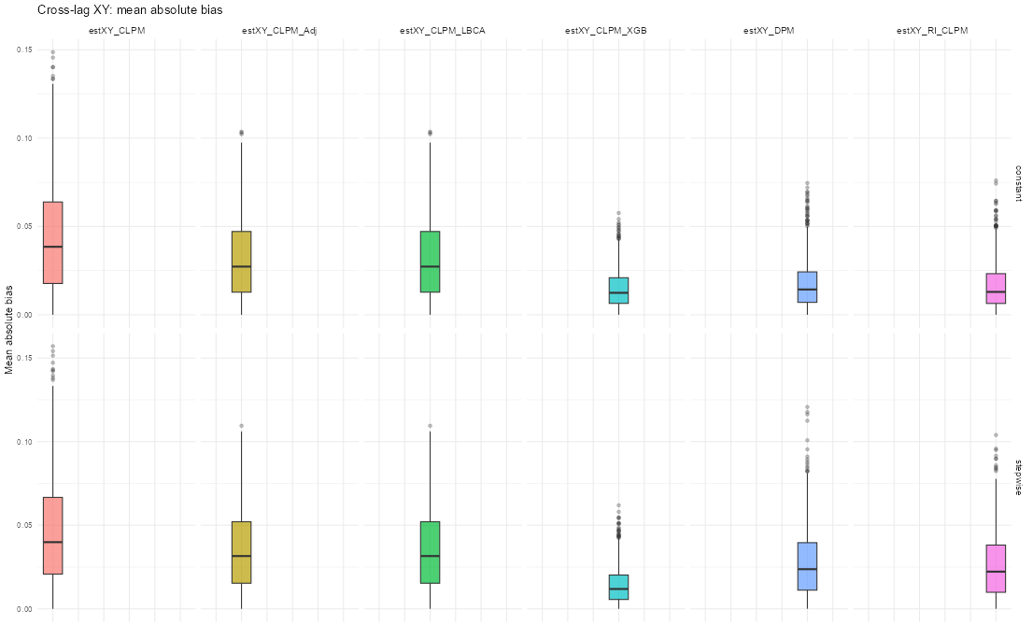
Study 2: Bias of XY (left) and YX (right)

Slide 17
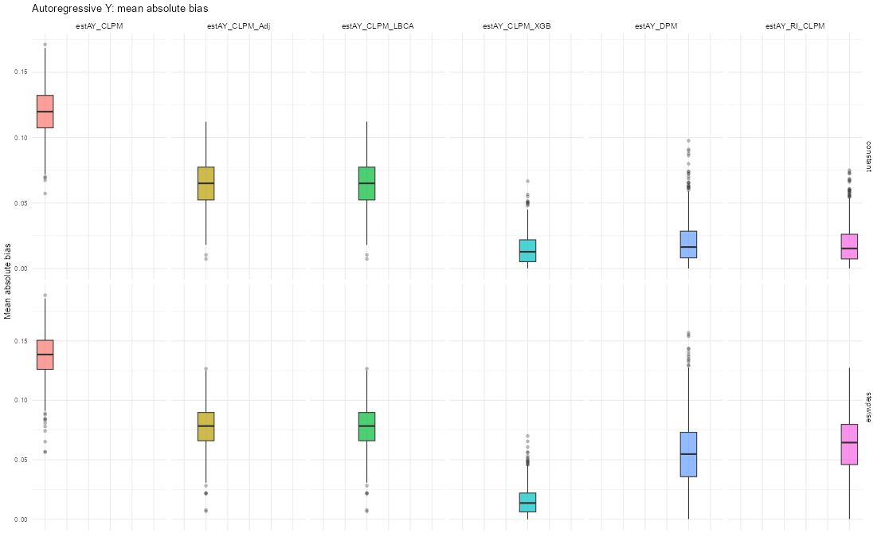
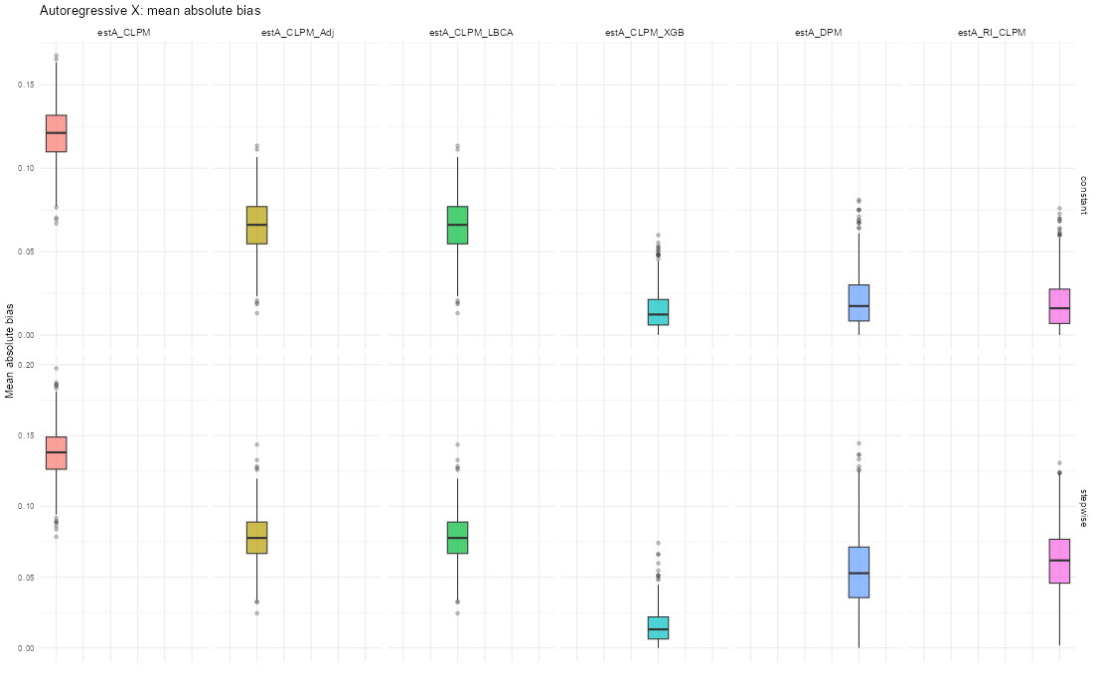
Study 2: Bias of AX (right) and AY (left)

